Slide 1
Presentation for Major Project:
HashtagVoyages- Intelligent Travel Planner website and mobile app
By:
Lakshya Sharma (A2305216488)
Kshitij Gupta (A2305216228)

Slide 2
Brief about the project :
Intelligent Travel Planner Website as well as mobile application.
Blogs for sharing the experience to others.
Different budget for different type of tourist.
Budget Splitter as unique feature for travelers to travel freely without thinking about splitting of unequal bills.
App for both solo traveler as well as group traveler
Off beat destination for explorers and a platform for providing their experience.
Travel accessories suggestion and Music playlist suggestion for better experience of traveling.
Surveys for our services, website and app experience.

Slide 3
The project:
Schema
Website: Hashtagvoyages demo
Mobile App: Hashtagvoyages demo
Social Media platform Stats: Instagram
Other Statistics display
My contribution
Outcome

Slide 4
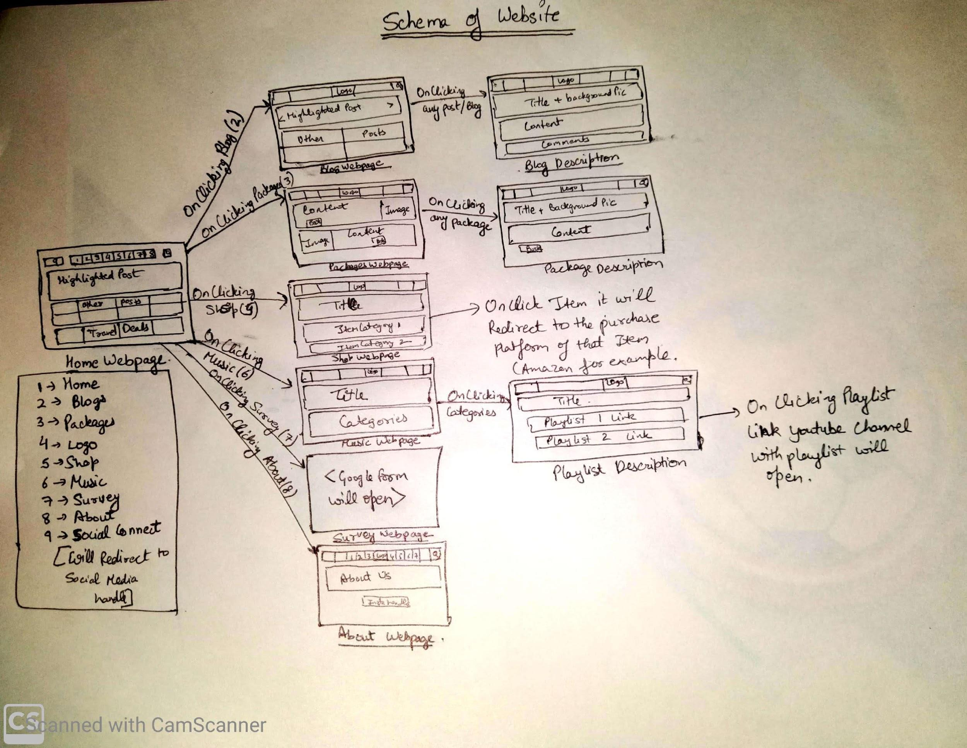
Schema:
Website Schema

Slide 5
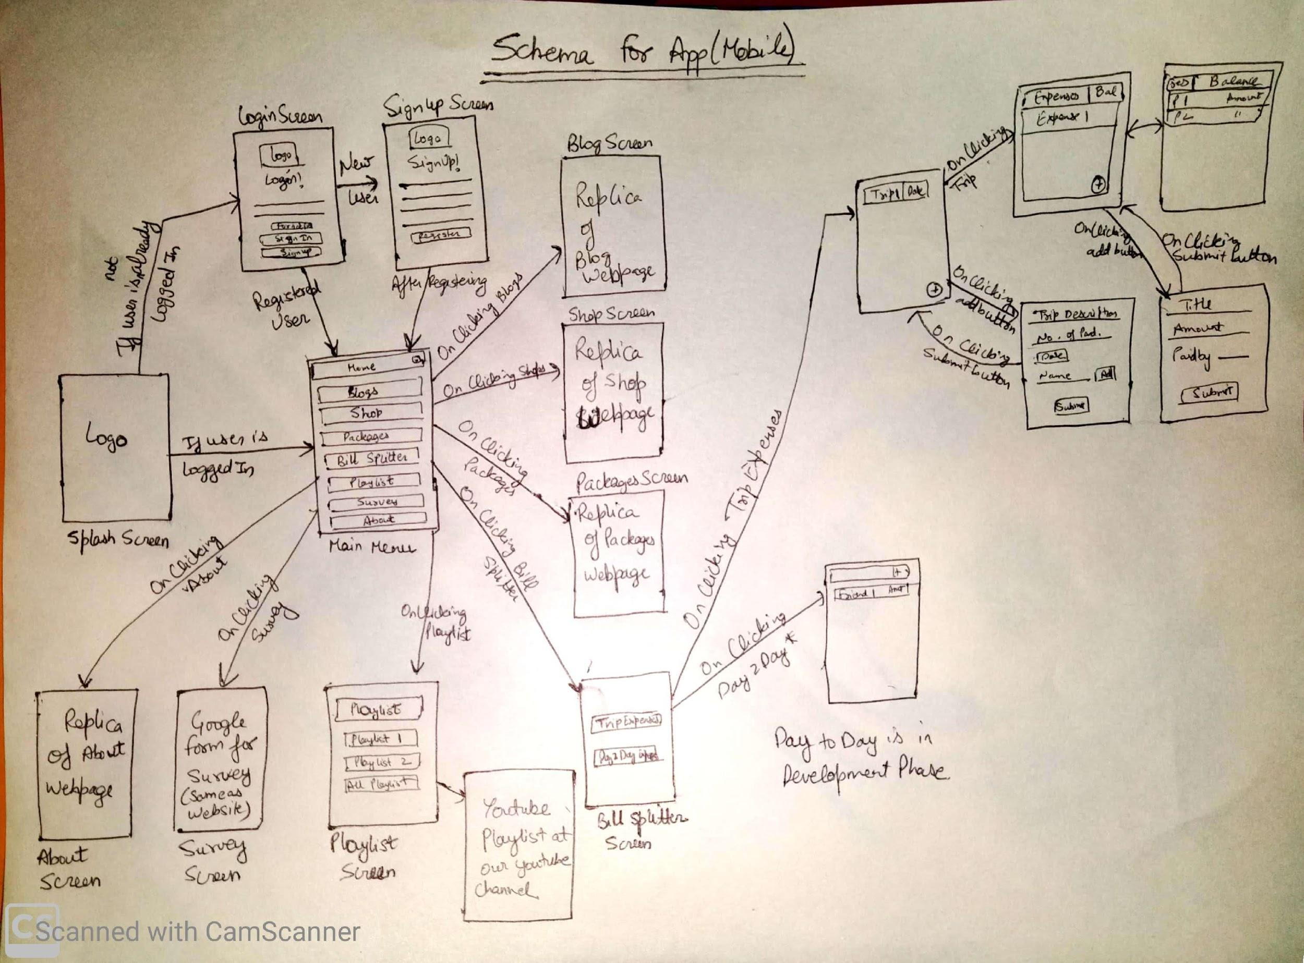
Schema:
Website Schema

Slide 6
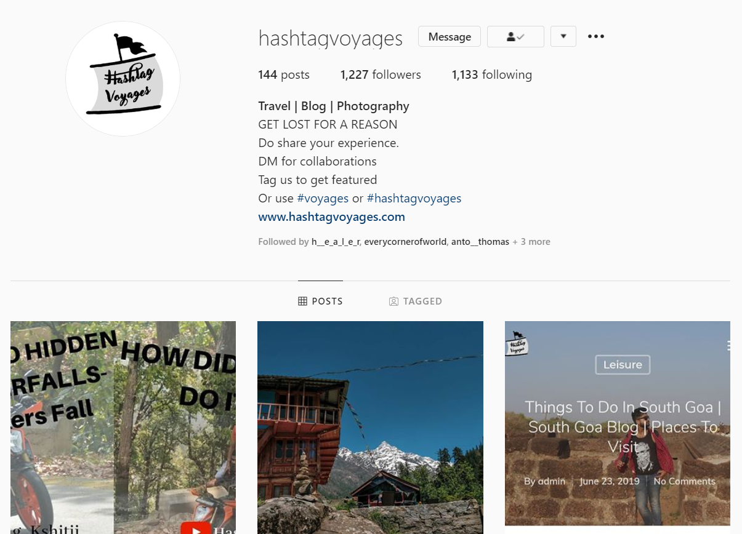
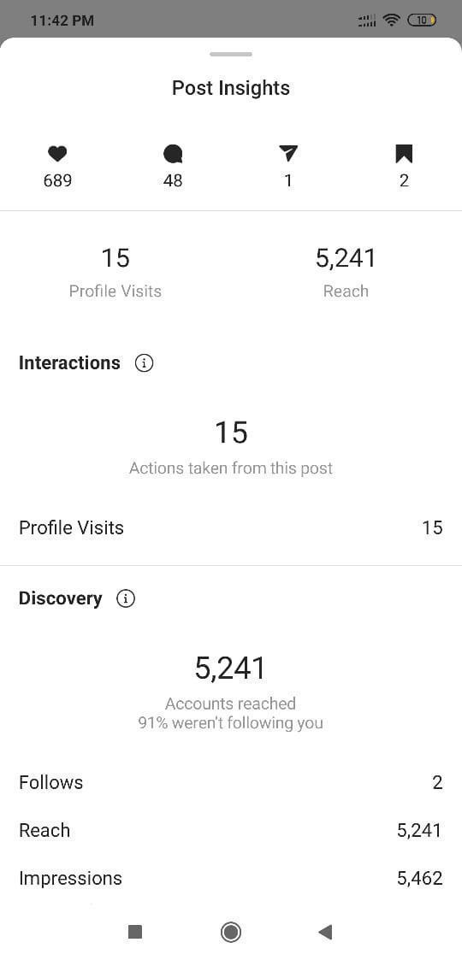
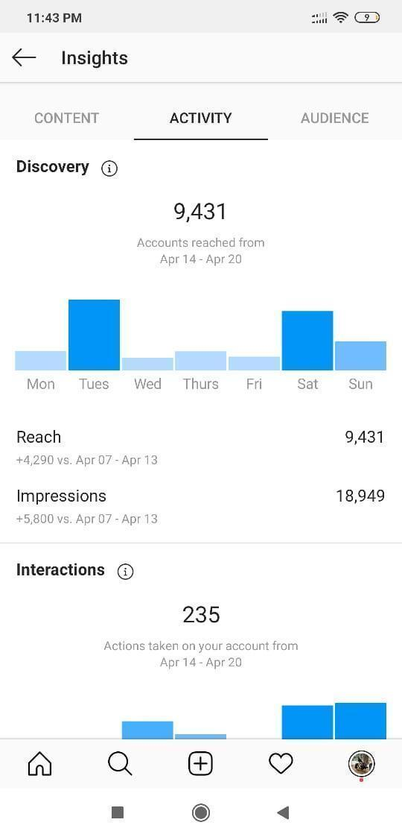
Instagram Stats:

Slide 7
Other Stats:
We have been constantly working on various digital marketing strategies to make our website appear on the SERP. SERP stands for Search Engine Result Page.
We have improved our Alexa ranking from 4 million to around 1 million.
The website has also slided in google index from 192 to 144. For the analysis, we have used the tool SemRush.
SemRush ranks have also improved, We started from 56.3M and now we are currently at 21.2M.
Using proper Keywords and placing them according to the hummingbird update of google, we did the On Page SEO of our site.
Building up quality backlinks to extract the link juice has also been used as a part of Off-Page SEO.

Slide 8
My Contribution
Developed the website.
Planned the schema of the application and website
Created youtube channel as well as instagram page for social platform presence.
Done all the digital marketing such as SEO, word search index, etc.
Made contacts with packages providers.
Created the blogs for the website and application.

Slide 9
My Outcome from Project:
Was able to understand how to work in a team and how to share workload.
Gained basic knowledge of app development, web backend and firebase.
Gained knowledge knowledge of web development, social media handling, Business management, digital marketing.
Gained knowledge of AI algos which we used in the app and website.
Will consider converting this project as startup idea.

Slide 10


